Slide 1

1st Wedding Anniversary

Slide 2

WHAT
1
Our 1st Wedding Anniversary

Slide 3
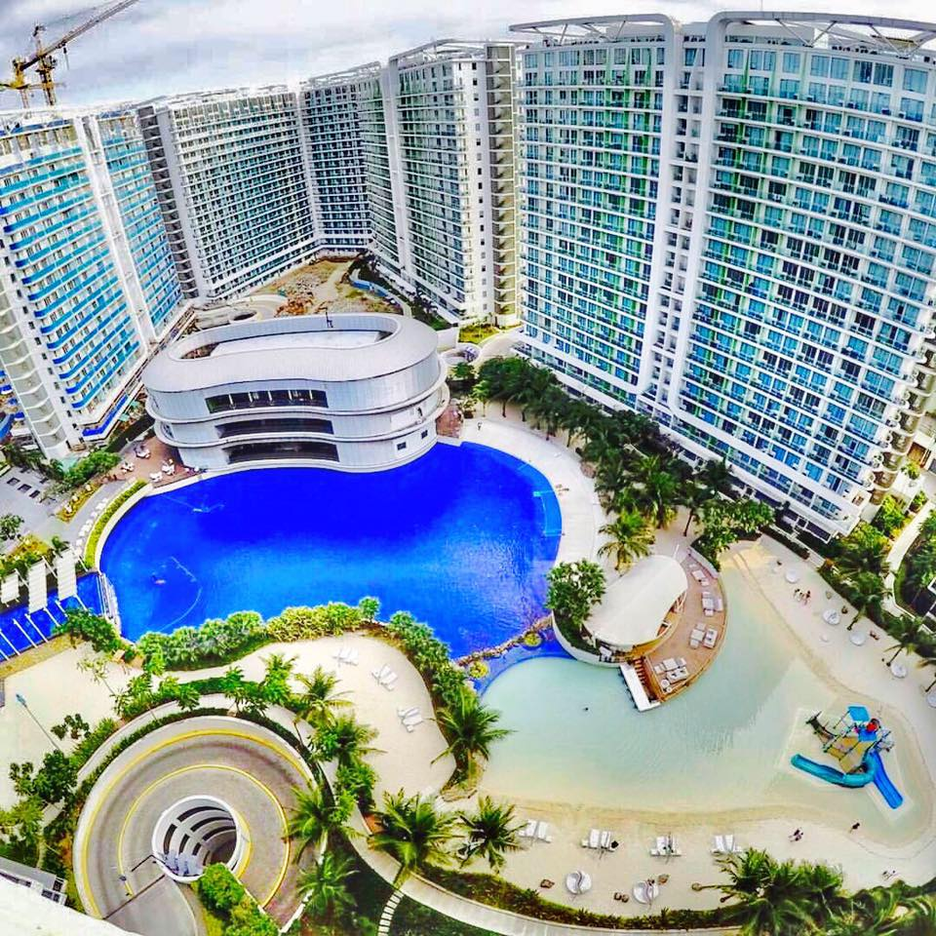
WHERE?
Azure Urban Resort Residences
Azure Urban Residences, KM 16, W Service Rd, Parañaque, 1700 Metro Manila

Slide 4
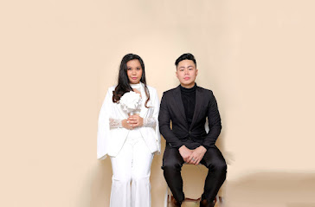
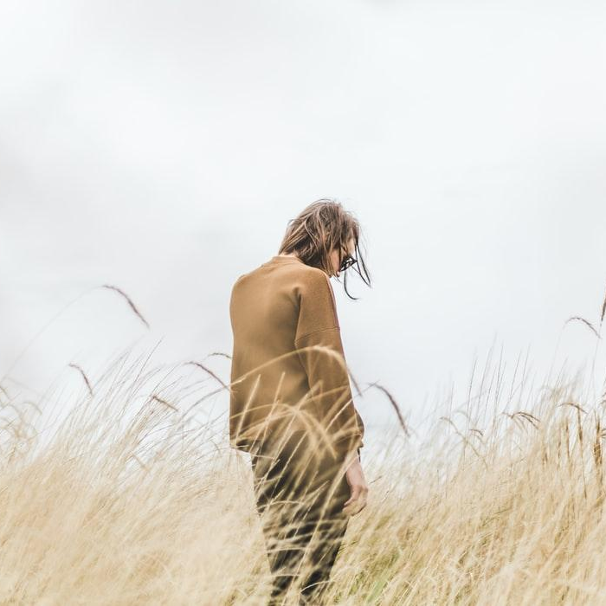
WHEN?
August 25, 2024
Time in: 2:00 pm August 27, 2024 Time Out: 12:00 pm

Slide 5
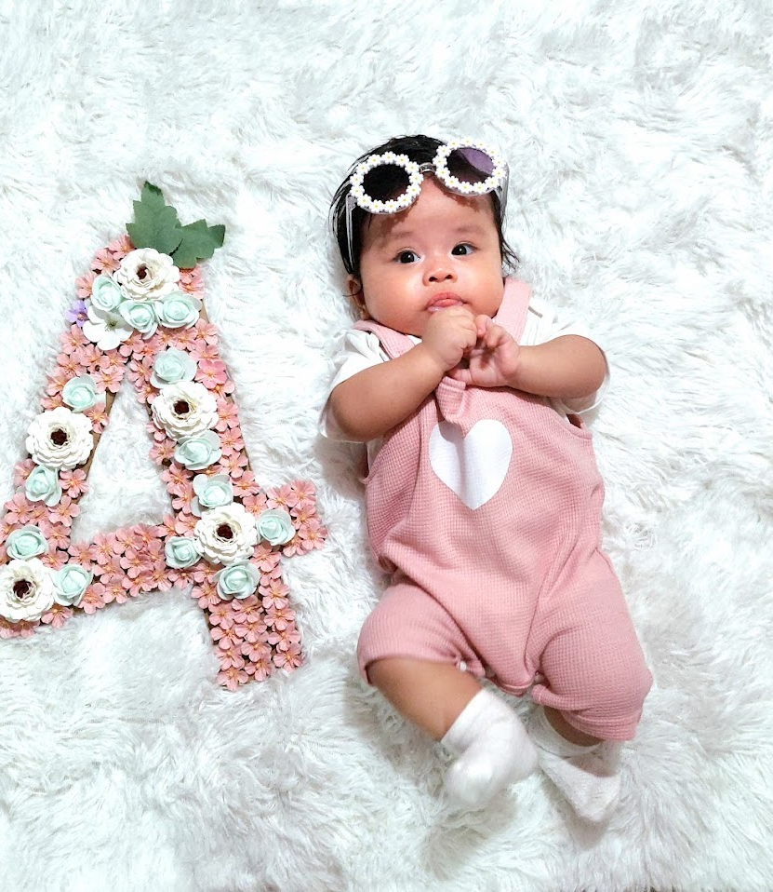

HOW ?
Day 1
Lunch
Dinner
Day 2
Breakfast
Lunch

Slide 6
NEEDS
Coffee
Rice (1 ½ ) – For Lunch and Breakfast
Drinks – Alcohol and Soft Drinks
Egg (4pcs)
Hotdog (4pcs)
Optional
Fries (1/2)

Slide 7
BUDGET
VENUE
Azure Urban Resort POOL
ITEMS
SAMGYUP
EGG
HOTDOG
RICE
DRINKS
FRIES
TRANSPORTATION
GRAB
CAROUSEL
JEEP
QTY
1
2
2
4
4
1 ½
2
½
2
2
2
PRICE
2,339
250
600
10
20
60
100
80
440
80
26
TOTAL
2,339
500
1200
40
80
90
200
80
880
160
52
TOTAL: 5,621

Slide 8
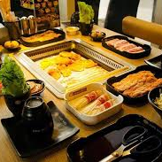
Dinner
SUMONICO- SAMGYUP

Slide 9
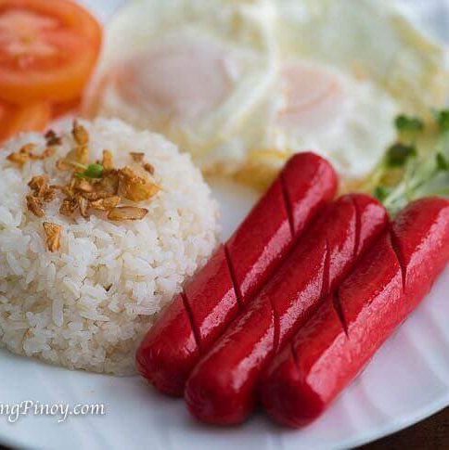
BREAKFAST
HOTSILOG Hotdog Sinaing Itlog

Slide 10
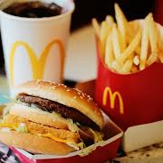
LUNCH
MCDO

Slide 11
SlidesCarnival icons are editable shapes. This means that you can:
Resize them without losing quality.
Change fill color and opacity.
Change line color, width and style.
Isn’t that nice? :) Examples:
Find more icons at slidescarnival.com/extra-free-resources-icons-and-maps

Slide 12
Diagrams and infographics

Slide 13
You can also use any emoji as an icon! And of course it resizes without losing quality.
How? Follow Google instructions https://twitter.com/googledocs/status/730087240156643328
✋👆👉👍👤👦👧👨👩👪💃🏃💑❤😂😉😋😒😭👶😸🐟🍒🍔💣📌📖🔨🎃🎈🎨🏈🏰🌏🔌🔑 and many more...

